Slide 1
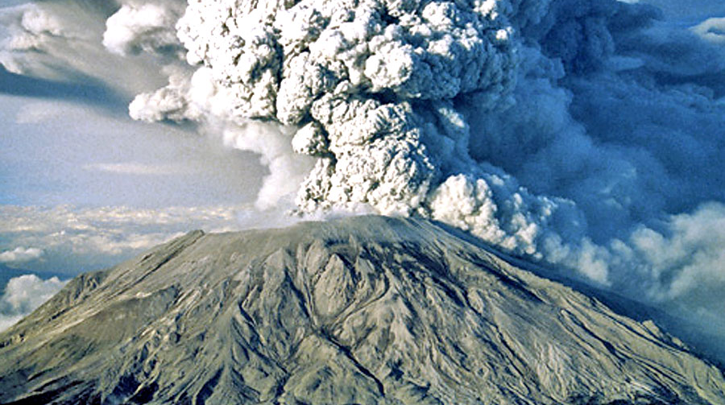
Volcanic Eruption Prediction
Presented By:
Abdulrahman Hussein
Farah Mahmoud AbdelMoneim
Magy Gamal Matta
Toka Ossama Barghash
Under Supervision of:
Prof. Walid Gomaa

Slide 2
Outline
Problem Definition
Related Work
Dataset
Methods
PreProcessing
CNN
DNN
LSTM
Preprocessing and RF
Experiments
CNN and DNN
LSTM and RF

Slide 3
Problem Definition
Every year about 60 volcanoes erupt and since the year 1500, about 280,000 people have been killed by volcanoes and about 170,000 of those people were killed by just six eruptions.
Therefore in our project we are detecting the time of volcanic eruptions which is specifically calculated from just after the last reading which is 60001 until the volcano erupt.
In 2019 paper titled "CRED: A Deep Residual Network of Convolutional and Recurrent Units for Earthquake Signal Detection" Mostafa Mousavi et al used CNN and bidirectional LSTM for earthquake signal detection which is the most close to our topic. Each of the two architectures is good in a way different than the other.
We also wanted to start with simple feature extractors like autocorrelation followed by regressor where we used random forests for that. We also tried Deep neural network.

Slide 4
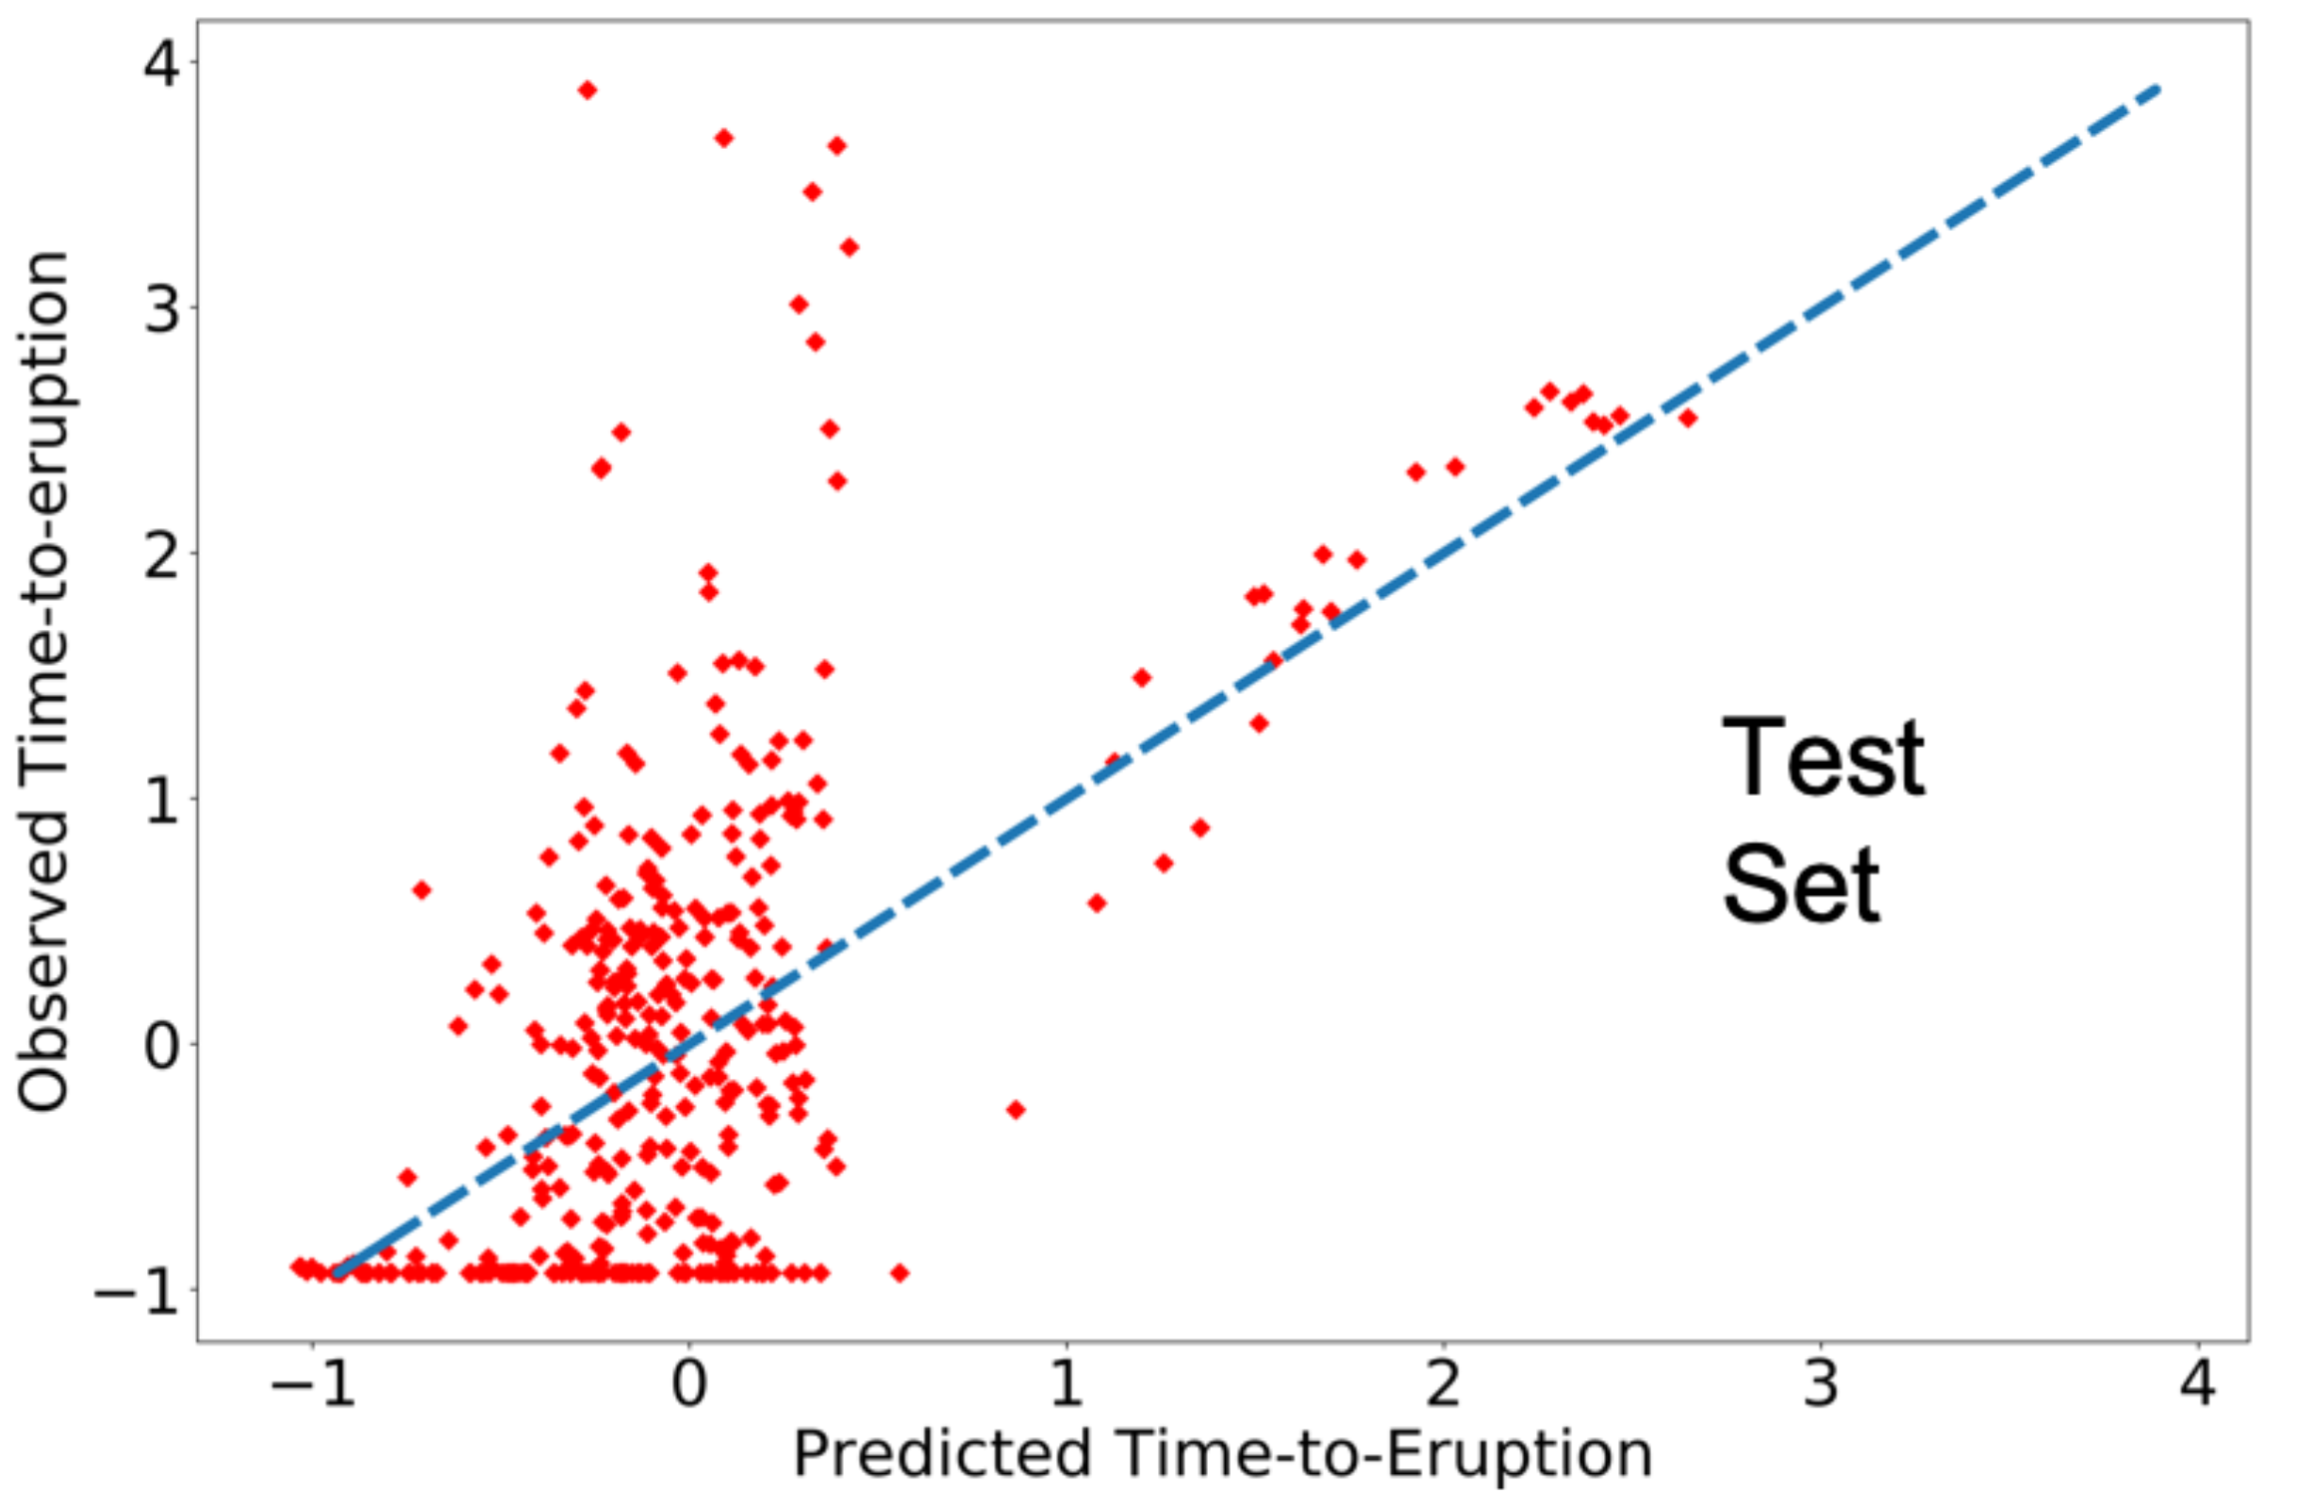
Related Work
Seismic monitoring is very correlated with all different activities in the volcano that helps in recognizing the signature of each activity in order to forecast volcanoes
Volcanic activities analysis: Tremors cross-correlation analysis to find harmonic tremors.
Figure 1 shows the results of random forest model on Kilauea earthquakes volcanoes to predict time-to-eruption.

Slide 5
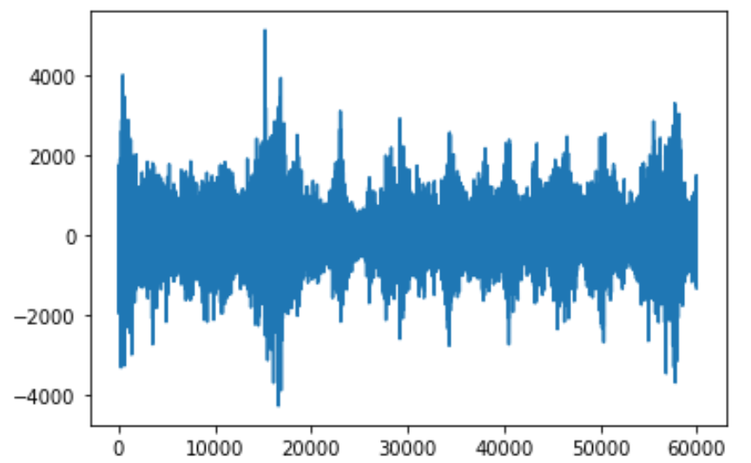
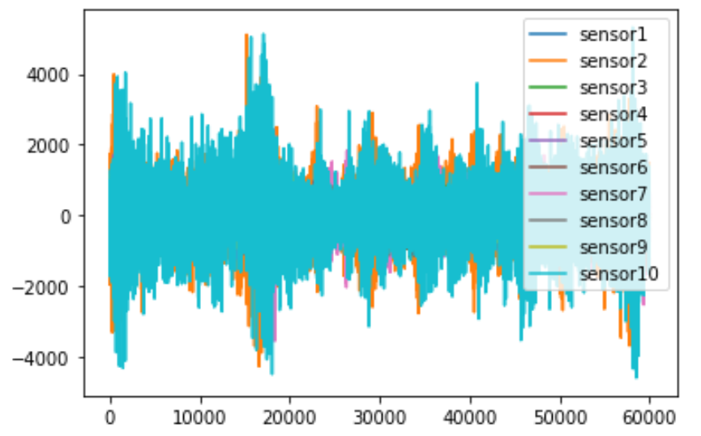
Dataset
Kaggle dataset from Volcanic Eruption Prediction Challenge
4,431 .csv labeled files (volcanoes) files named after the ID of each volcano
Another 4520 unlabeled files for testing.
One label file to all volcanoes defining time left to next eruption ranging from 6250 to 49 Million time unit.
Ten minutes of logs from ten different seismic sensors arrayed around the volcano
Data is divided to 75\% training, 18.75\% validation and 6.25\% testing.

Slide 6
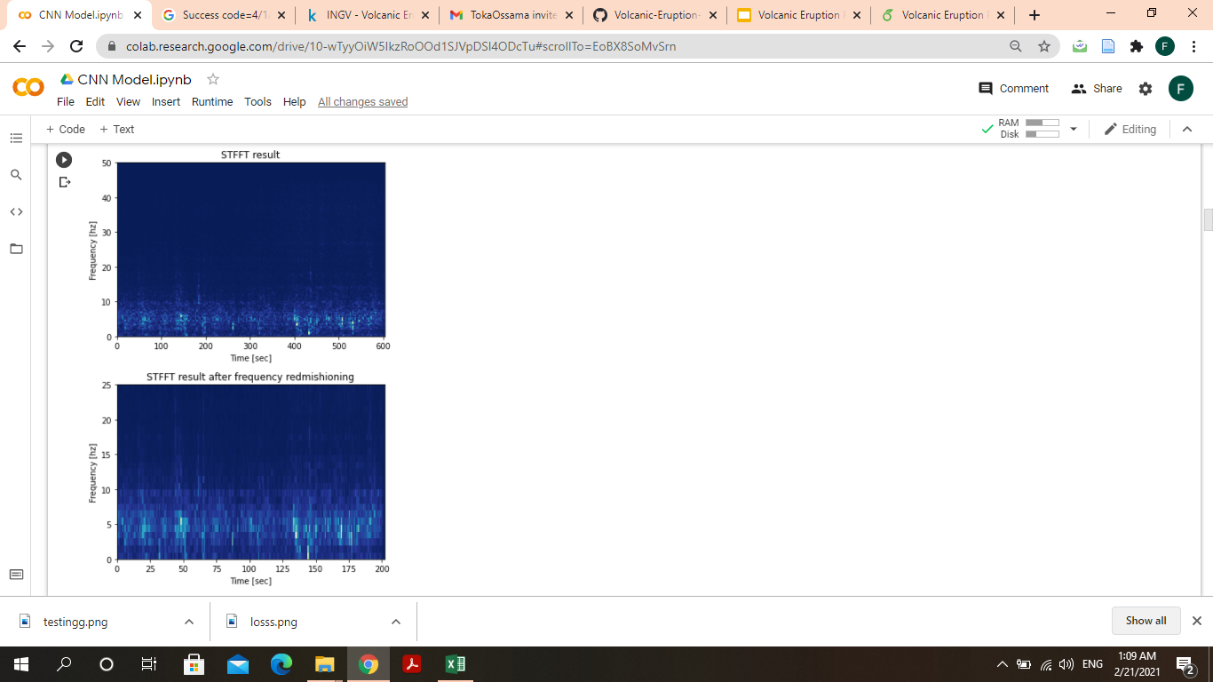
Methods (Pre-processing)

Slide 7
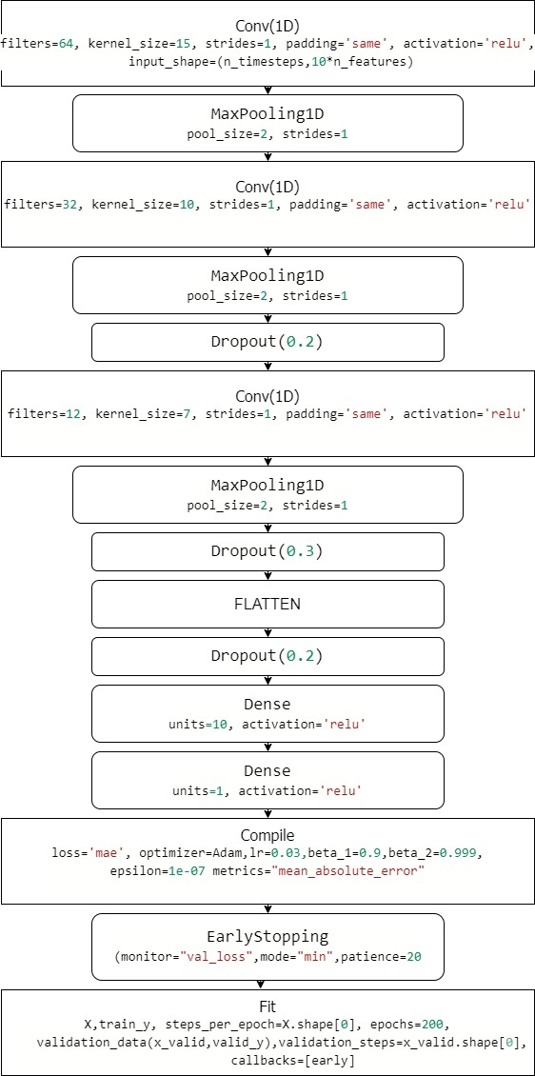
Methods (CNN)

Slide 8
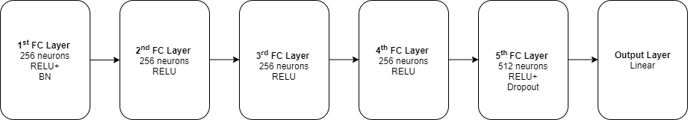
Methods (DNN)

Slide 9
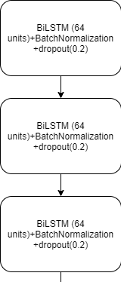
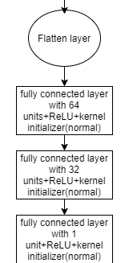
Methods (LSTM)

Slide 10
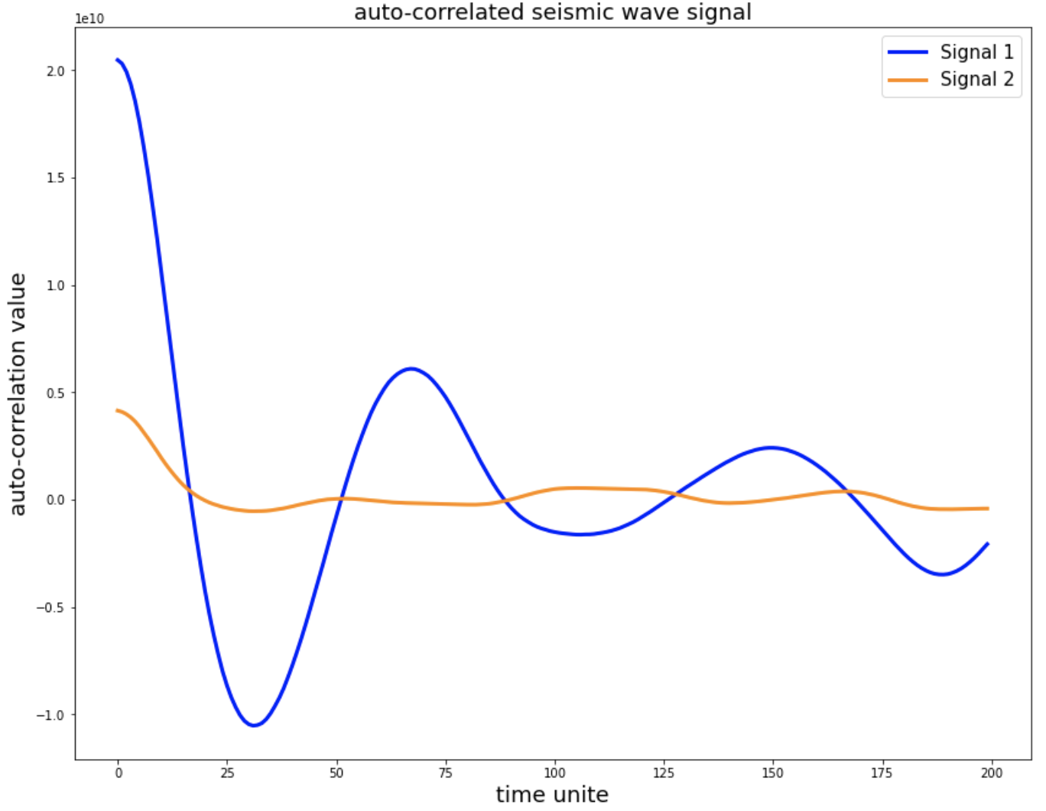
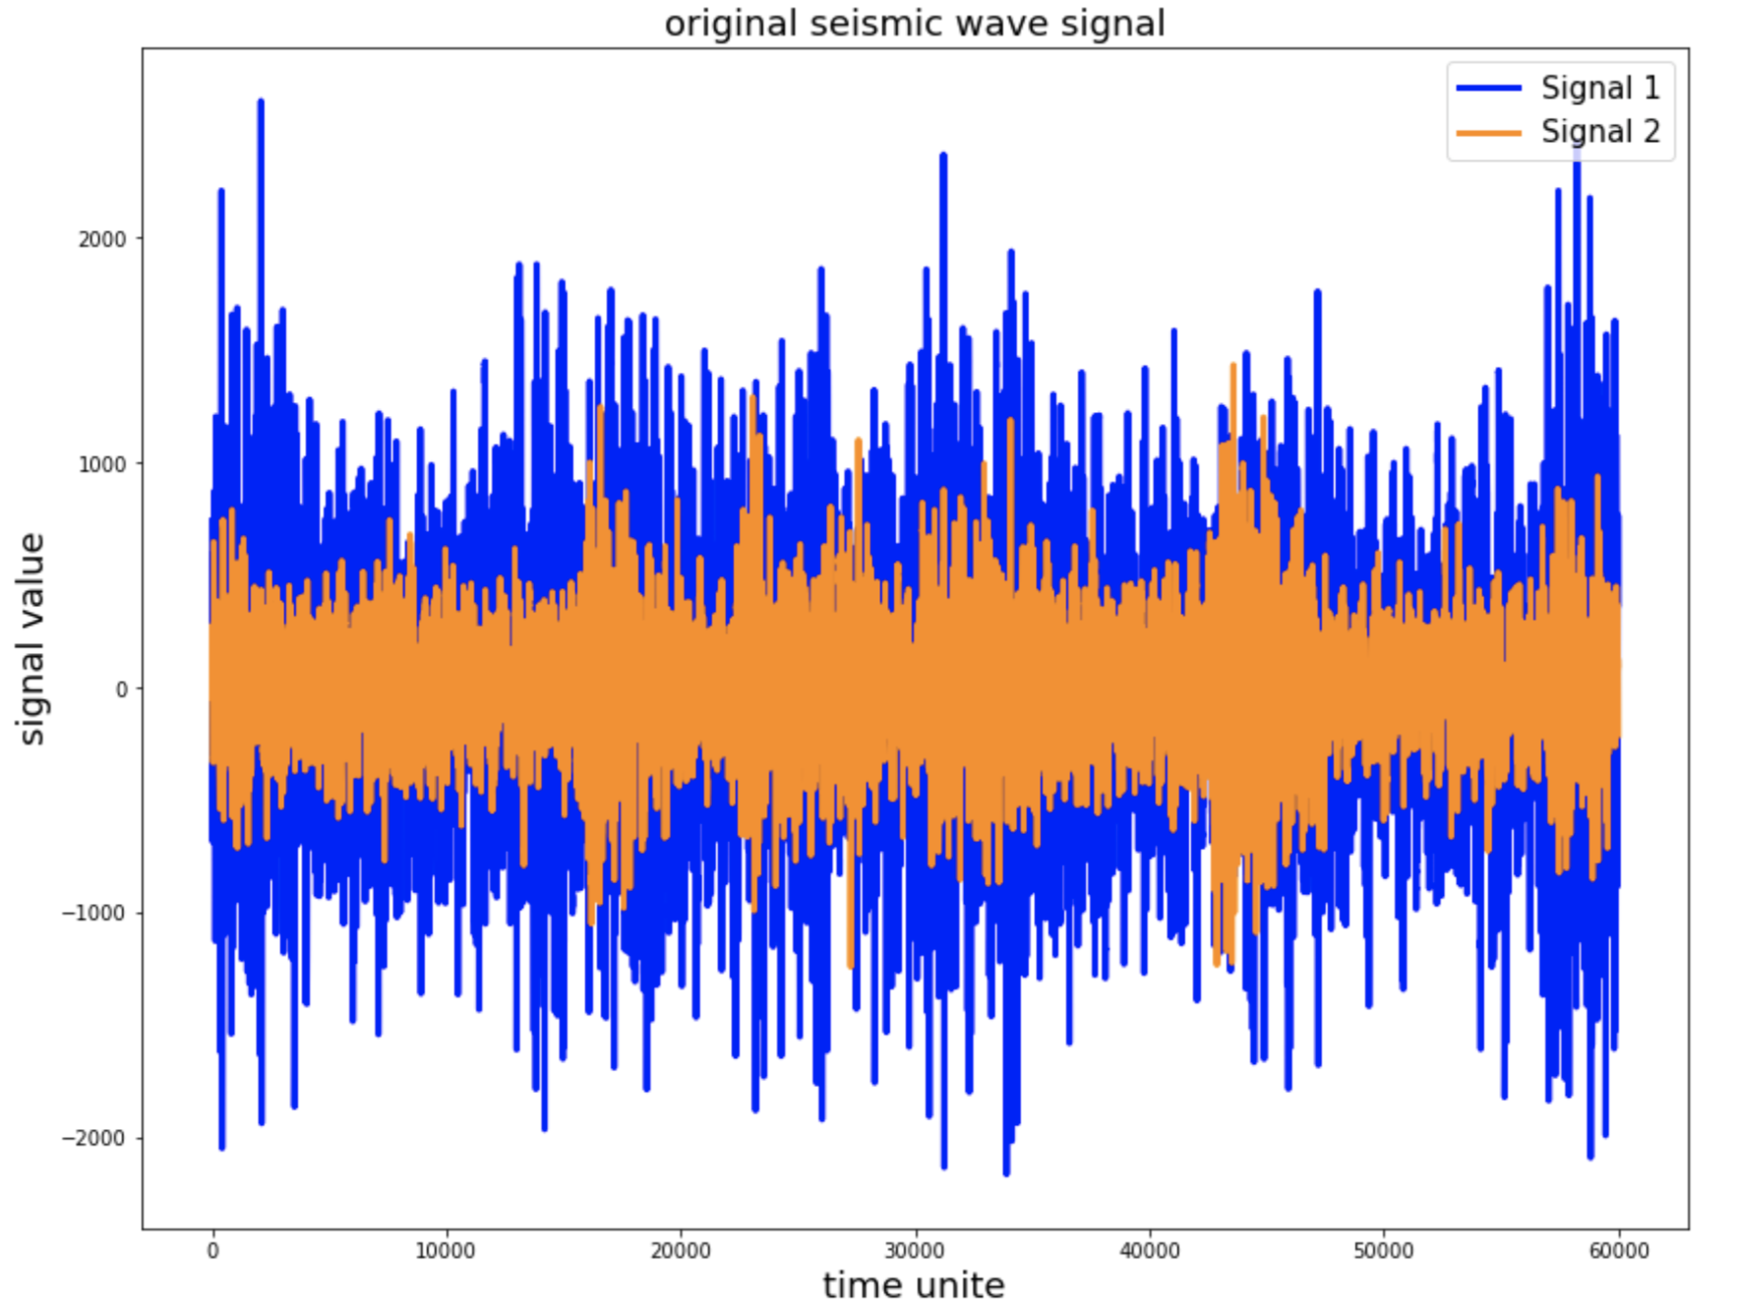
Methods (Preprocessing and RF)
Auto-correlation
Convolution of signal with its lagged version

Slide 11
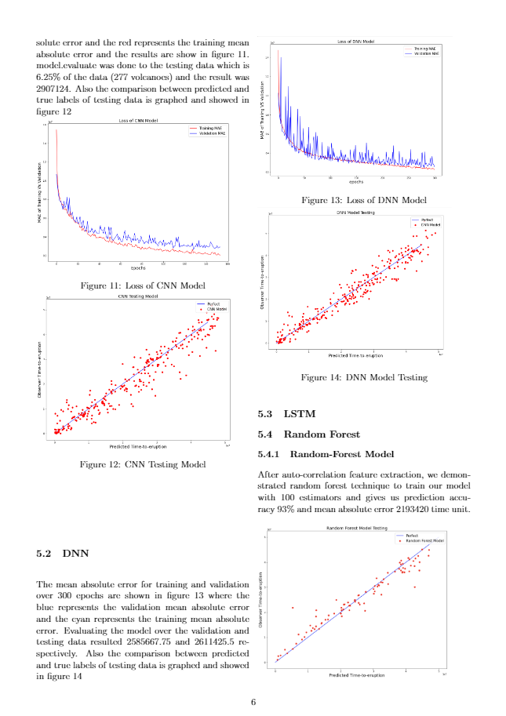
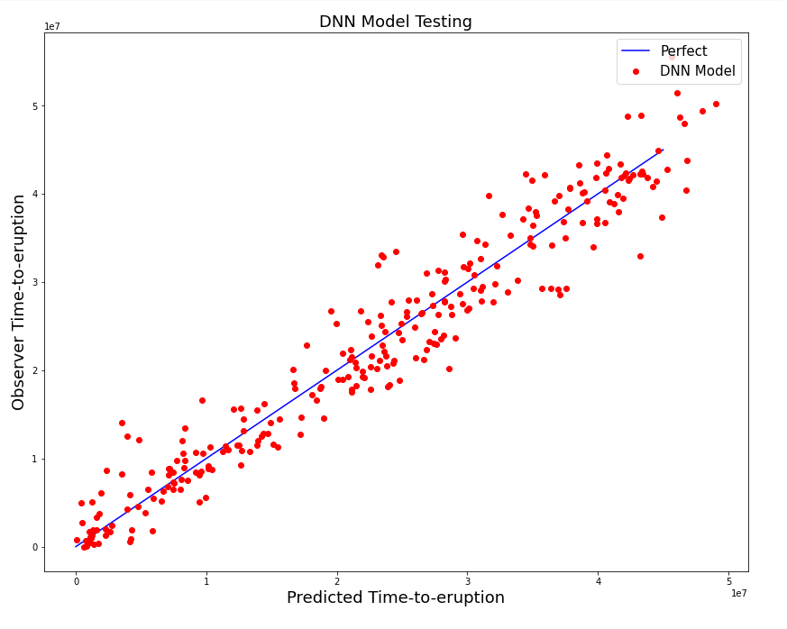
Experiments (CNN and DNN)
CNN
DNN
Validation loss | Testing loss | Submission Loss
2904451.25 | 2907124 | 6042665
Validation loss | Testing loss | Submission loss
2585667.75 | 2611425.5 | 6230261

Slide 12
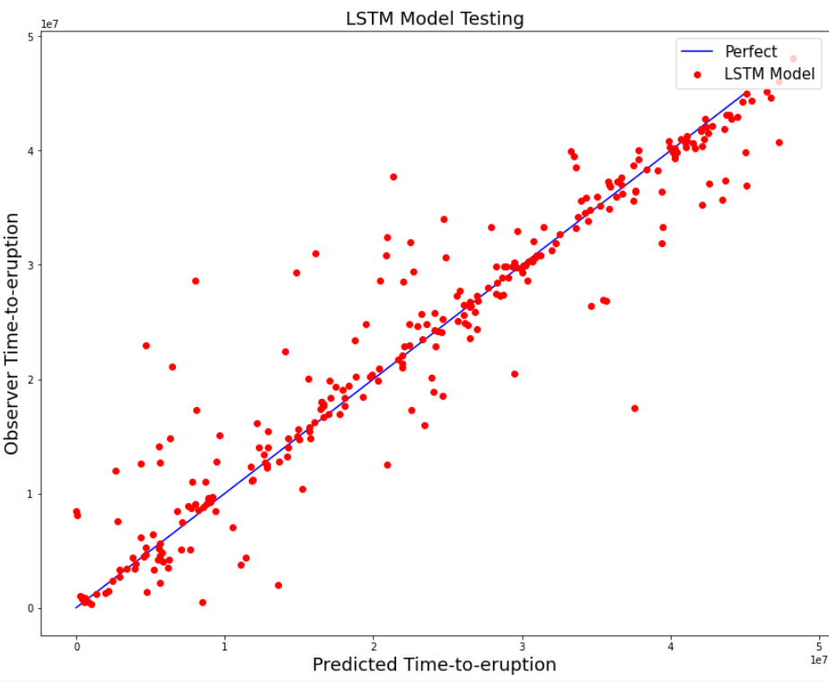
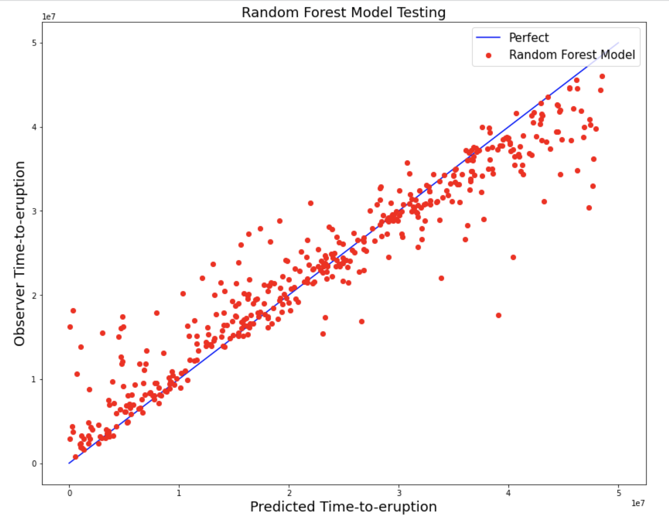
Experiments (LSTM and RF)
LSTM
Validation loss | Testing loss | Submission Loss
343475.3819 | 2460357.5 | 6125066
Validation loss | Testing loss | Submission loss
- | 2705934 | 13296316

